Slide 1
AIML LAB 2
Name: Liang Zheng Kai Lucas
Admin No.: P2222770
Class: DAAA2A06

Slide 2
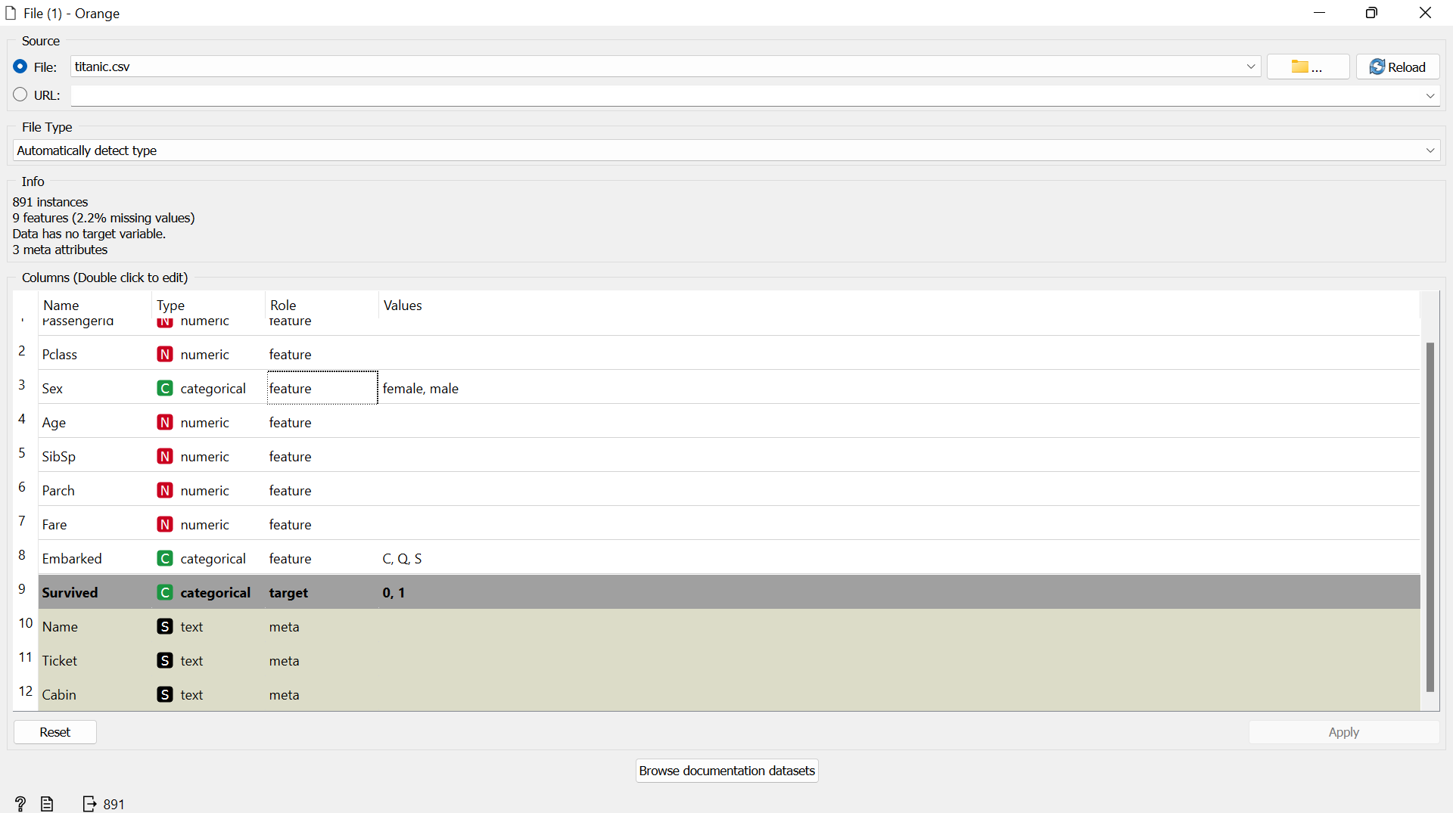
Step 1: I import the titanic.csv file and set the ‘Survived’ feature as the target
I set the target to this feature as I want to predict who will survive the Titanic disaster.

Slide 3
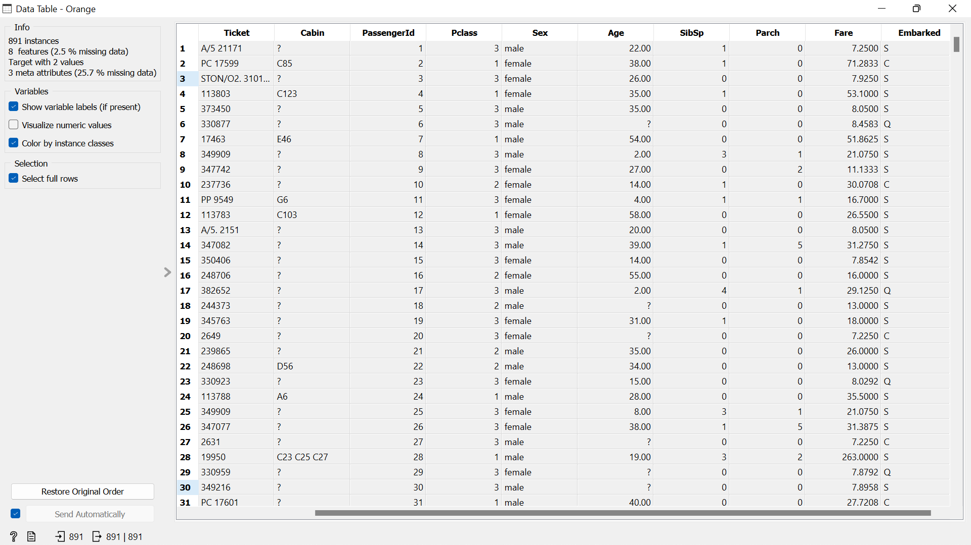
Step 2: Connect the file to a Data Table to observe the dataset
From here I observe that there are missing values in the ‘Cabin’ and ‘Age’ feature

Slide 4
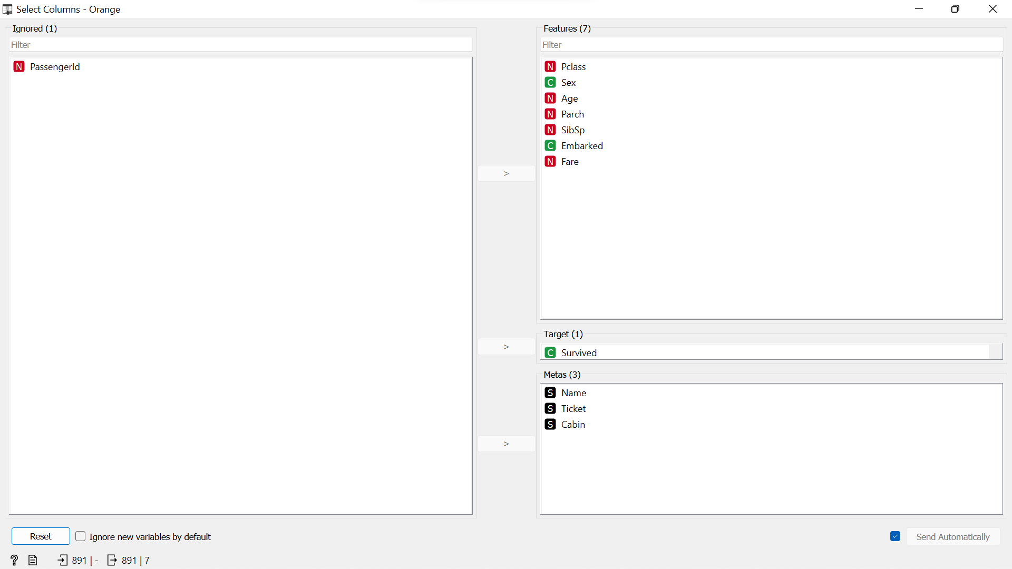
Step 3: Remove features which I find do not aid in the model training
Aside from the Metas that are not used, I ignored the feature ‘PassengerId’

Slide 5
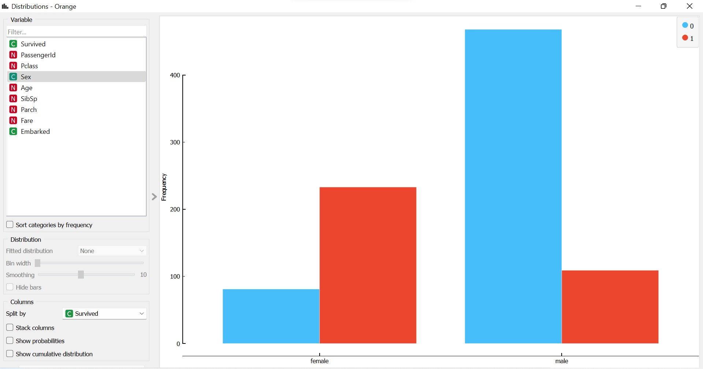
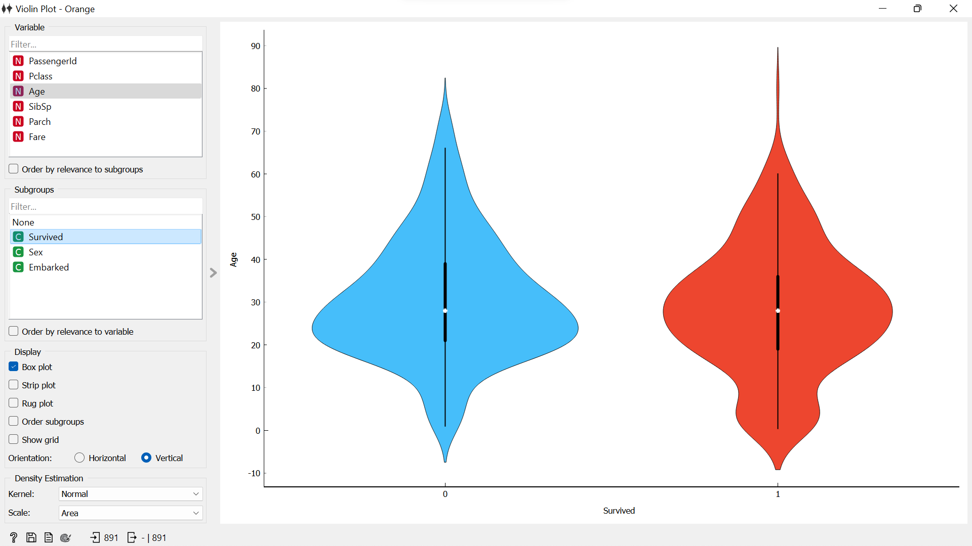
Step 4: Visualize the data
From the count plot, we notice that more females survived compared to males
From the violin plot, we notice that the age of those who survived is bimodal (0-10 years old & 25-35 years old)
Such observations are important the machine learning algorithm to recognize when predicting who would survive the titanic

Slide 6
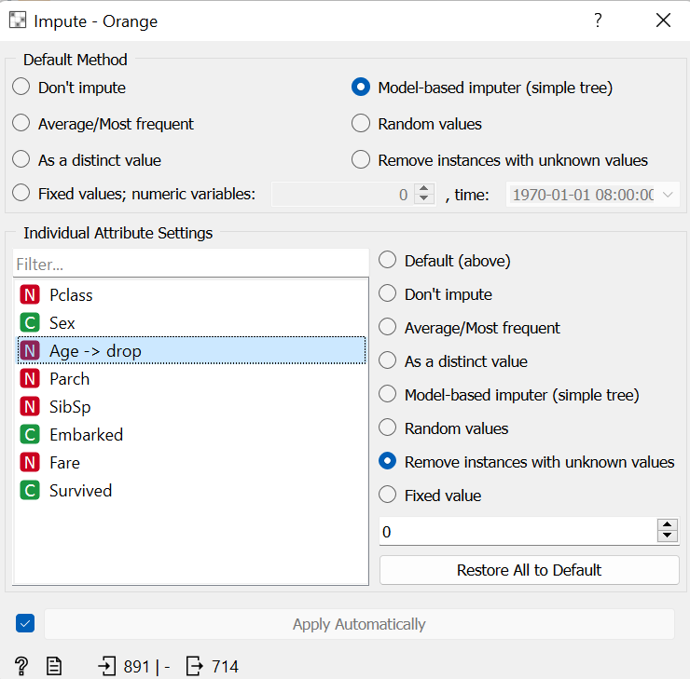
Step 5: Cleaning the data
From step 2, I know that aside from the ‘Cabin’ feature (Meta), the ‘Age’ feature also has unknown values
As age is a factor that is hard to predict using the data given (predicting might cause skewness, causing inaccuracy)
I decided to drop rows with unknown values of age

Slide 7
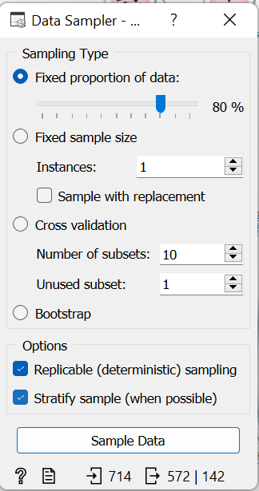
Step 6: Sampling the data
I split the original dataset into training data and testing data at a fixed proportion of 80%.
Training data is used to build the machine learning model
Test data is used to evaluate the machine learning model

Slide 8
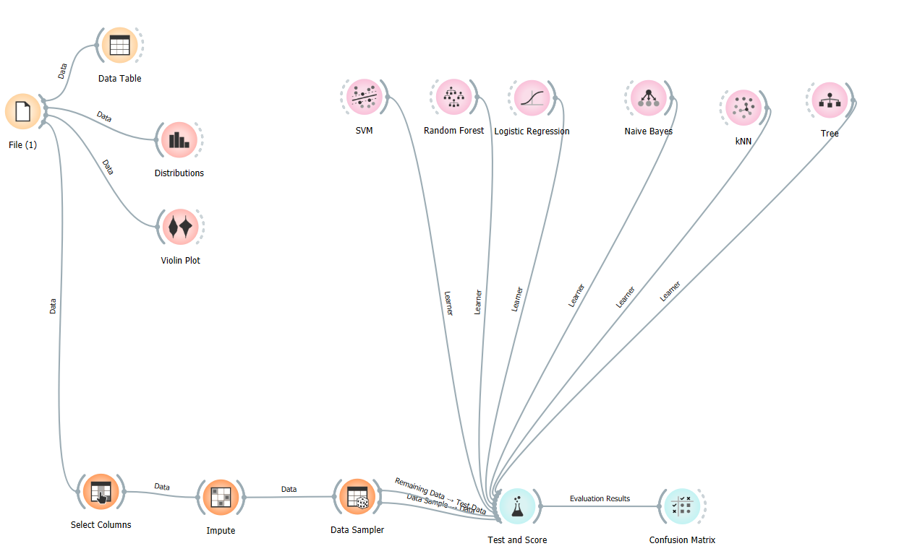
Step 7: Add models to the workflow
After sampling the data, I assigned the data sample (80%) as test data and the remaining data (20%) as sample data
For the case of the titanic, I felt that classifications models for supervised learning should be used
Thus, I decided to test models such as SVM, Random Forest, Logistic Regression etc..

Slide 9
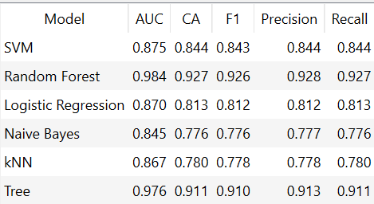
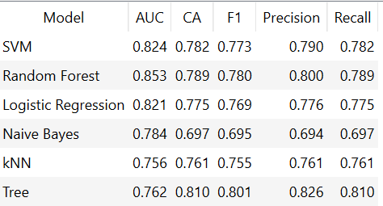
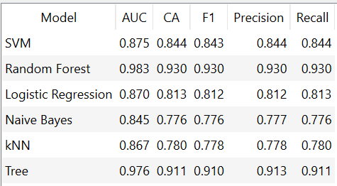
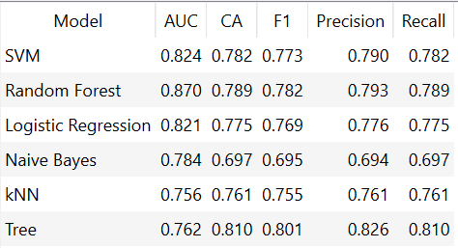
Step 9: Interpreting the results
Train data:
Test data:
Train data:
Test data:
After sampling the data twice, I obtained 2 pairs of results for train and test data.
From the results, I can determine that the best model for predicting would be Tree.
Even though the accuracy of the train data is not the highest for Tree, the accuracy of the test data is the highest amongst other models indicating a good fit

Slide 10
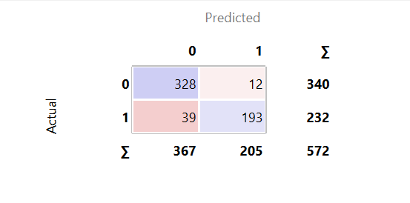
Step 10: Visualize results
For the Tree model, this is the visualized result
Out of the 367 people who did not survive, 328 were predicted to have not survived and did not survive (True Positive), and 39 were predicted to have not survived but survived (False Positive)
Out of the 205 people who survived, 193 were predicted to survived and survived (True Negative), and 12 were predicted to survive but did not survive (False Negative)

Slide 11
Thank you

